Slide 1
Module Three
Contemporary
Theories of Motivation

Slide 2
MOTIVATION
A need is :
an experienced state of deficiency that pushes one’s behaviour.
examples: hunger, thirst and pay rise
A motive:
Pulls behaviour in a predictable direction.
Dr.Ahmed Radwan

Slide 3
Motivation
Motivation is defined as:
- The psychological process that gives behavior purpose . and direction
- An internal drive to satisfy an unsatisfied need .
- Motivation is the inner force that drives individuals to accomplish personal and organizational goals.
Dr.Ahmed Radwan

Slide 4
Work Motivation
Work motivation is:
The direction, level of effort and extent of persistence evident in the behaviour of an employee.

Slide 5
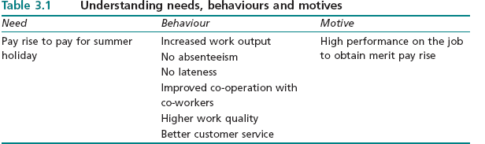
Need, Behaviour and Motive
Dr.Ahmed Radwan

Slide 6
Importance of Motivation
Motivation sustains behaviour and keeps it systematic and focused.
It directs responses towards the valued goals.
Motivation stimulates employee behaviour
to achieve organisational goals.
Dr.Ahmed Radwan

Slide 7
Motivation & Performance
* Performance always involves the evaluation of a person’s behaviour on the job.
* Motivation is only one of several factors that influence performance.
* Low motivation does not necessarily cause low performance
Dr.Ahmed Radwan

Slide 8
Factors Affecting Performance
- Ability & Skills - Motivation
- Resources - Working Conditions
- Difficulty of the task
- Personality Characteristics
- Organisational Commitment & job involvement
Dr.Ahmed Radwan

Slide 9
Motivation Theories
Herzberg
2-Factor
Theory
B Mod
Skinner
Expectancy
Theory
Vroom&
Tolman
MOTIVATION
Equity
Theory
S. Adams
Maslow
Hierarchy
Dr.Ahmed Radwan

Slide 10
Types of Motivation Theories
I. Content theory of motivation:
specifies factors in individuals which stimulate, direct, sustain and stop behaviour.
  It explains: ‘What specific needs cause motivation?’
II. Process theory of motivation:
explains how behaviour is stimulated, directed, sustained, or stopped.
  It explains “how motivation occurs”.
Dr.Ahmed Radwan

Slide 11
Content Theories
of Motivation
Dr.Ahmed Radwan

Slide 12
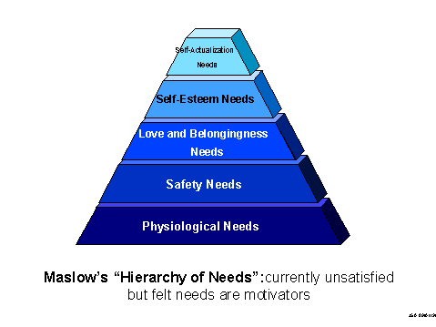

Maslow Pyramid
Dr.Ahmed Radwan

Slide 13

Maslow Hierarchy of Needs
Level I - Physiological Needs:
the most basic human needs e.g. food, water and comfort.
The organization helps to satisfy employees' physiological needs by a paycheck, safe working conditions.
Level II - Safety Needs :
the desires for security and stability & to feel safe from harm.
Dr.Ahmed Radwan

Slide 14
Maslow Hierarchy of Needs
Level III - Social Needs:
The desire to give and receive affection. e.g. friendship,
The desire for acceptance & giving and receiving support.
The organization helps to satisfy employees' social needs . e.g. sports teams and celebrations & by showing direct
care and concern for employees.
Dr.Ahmed Radwan

Slide 15
Maslow Hierarchy of Needs
Level IV - Esteem Needs:
* The desires for self-respect and recognition by others.
* It has an external component identified as social status, which is defined as recognition, prestige & appreciation .
* The internal component is challenge and autonomy .
* The organization satisfies employees' esteem needs through promotion & recognition with awards.
Dr.Ahmed Radwan

Slide 16
Maslow Hierarchy of Needs
Level V - Self-Actualization Needs:
The realization of the individual full potential & to fulfill oneself by making maximum use of talents and experience.
  e.g. assigning a challenging task
  An engineer uses all of his design skills to create a new subcomponent.
Dr.Ahmed Radwan

Slide 17
Maslow Hierarchy of Needs
Self efficacy ‘can do’ trait is defined as personal confidence to achieve a very high level of performance.
Higher order needs are learned, develop them through sustained contact with the social environments and they function at psychological levels
Being a mentor can be a self actualizing pathway.
Dr.Ahmed Radwan

Slide 18
Maslow Hierarchy of Needs
Becoming an entrepreneur can be a powerfully sustaining form of self actualisation .
It strongly and consistently reinforces the human desire for self determination.
Great success in one’s career leads to greater satisfaction of the internal component of the esteem need and enhanced intrinsic motivation.
Dr.Ahmed Radwan

Slide 19
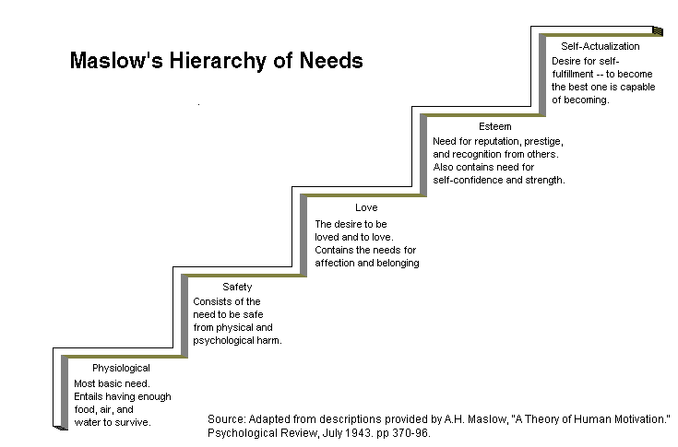
Dr.Ahmed Radwan

Slide 20
Maslow Hierarchy of Needs
  Physiological and safety needs are Low order needs
  Other needs are called Higher-order needs
  Physiological needs have to be satisfied first.
  Lower order needs become less important as they are satisfied while there is no decline in the importance of higher order needs as they are satisfied.
Dr.Ahmed Radwan

Slide 21
Maslow Hierarchy of Needs
Unmet needs are more motivating than needs
which have been satisfied.
Unsatisfied employee needs lead to undesirable outcomes at work.
In early career stages, employees focus on job security and on developing an accepted position in the organisation.
By mid career, their attention shifts to recognition, autonomy and self development.
Dr.Ahmed Radwan

Slide 22
Maslow Hierarchy of Needs
Managers must direct employee behaviour that meets both,organisational and individual needs .
The quality of an organisation’s motivational programme is determined by the clarity of
pathways between employee performance and rewards.
Dr.Ahmed Radwan

Slide 23

SATISFACTION
MOTIVATORS
NO SATISFACTION
NO DISSATISFACTION
HYGIENE
DISSATISFACTION
2-Factor Theory
Dr.Ahmed Radwan

Slide 24
2-Factor Theory
Herzberg Theory
Hygiene such as pay, pension and job security, if they do not get fulfilled ,the result will be job dissatisfaction.

Slide 25

HYGIENES
PAY
CO. POLICIES
SUPERVISION
PEER RELATIONS
JOB SECURITY
WORK ENVIRONMENT
Dr.Ahmed Radwan

Slide 26
Motivator such as achievement, involvement, interesting ,challenging work and recognition, are the factors that cause job satisfaction & enhance performance.
* Motivators are related to the employee–job interaction, and are job centred characteristics.
* They are called intrinsic job factors or content factors
Dr.Ahmed Radwan
Frederick I. Herzberg
(1923-2000)

Slide 27
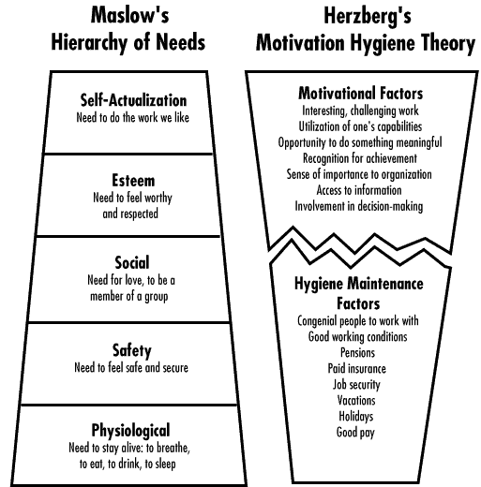
Dr.Ahmed Radwan

Slide 28
Comparing Maslow’s and Herzberg’s Models
Herzberg is concerned with job satisfaction and dissatisfaction.
Maslow focused on human needs which encompass a variety of life situations, one of which is work.
Maslow’s lower order needs resemble hygiene factors
Dr.Ahmed Radwan

Slide 29
Process Theories
of Motivation
Dr.Ahmed Radwan

Slide 30
EQUITY THEORY
Social Comparisons in the Work Setting
Employees seek the fairness of their work outcomes in comparison to the work outcomes received by others in similar jobs.
Dr.Ahmed Radwan

Slide 31
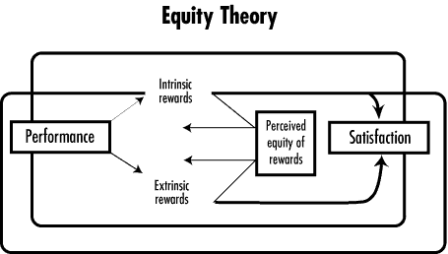
Social Comparisons
in the Work Setting
“ Adams”
Dr.Ahmed Radwan

Slide 32
EQUITY THEORY
Inequities exist whenever employees feel that their rewards for their efforts are different than the rewards received by others for their efforts
A negative inequity occurs when employee believes that he has received relatively fewer than others in proportion to his effort.
A positive inequity occurs when employee believes that she has received relatively more than others in proportion to her level of efforts.
Dr.Ahmed Radwan

Slide 33
EQUITY THEORY
  People who feel positive inequity are motivated to increase both the quality and quantity of work
  Underpaid & overworked employee compensate by decreasing the quality and quantity of their work
  Negative inequity is stronger than positive inequity.
  Employees are less likely to correct an “overpaid” imbalance than an “underpaid” imbalance.
Dr.Ahmed Radwan

Slide 34
EQUITY THEORY
If rewards are to motivate employees,
they must be perceived
as being Equitable and Fair
Dr.Ahmed Radwan

Slide 35
Types of Individuals Preferences
For Equity
Benevolents are employees who are comfortable with an equity ratio which is less than that of their comparison others.
Equity Sensitives are those employees who prefer equity which based on the original formula.
Entitled are those employees who are comfortable with an equity ratio which exceeds that of their comparison others (slackers).
Dr.Ahmed Radwan

Slide 36
Restoring State of Equity
Change work inputs and reduce performance efforts
Change the outcomes received (ask for more responsibility to reduce positive inequity)
Exit the circumstances (leave a job or request a transfer)
Change people who are used for comparison
Mentally distort or alter the comparison (rationalize inequity as only temporary ,will be resolved in the future.
Try to alter the outcomes of the comparison to others .
Dr.Ahmed Radwan

Slide 37
Managerial Applications
1- Tell employees in advance about salary ranges, pay increases and promotion opportunities.
2- Avoid practices which encourage secrecy about pay policies and procedures.
The employees must understand pay ranges and the relationship between excellent performance and valued rewards (instrumentality).
Dr.Ahmed Radwan

Slide 38
EXPECTANCY THEORY
An individual will consider the outcomes associated with various levels of performance and elect to pursue the level that generates the greatest reward for him or her.
Behaviour can be channelled and directed.
Dr.Ahmed Radwan

Slide 39
EXPECTANCY THEORY
The expectancy theory of motivation was developed by Tolman.
He realized that behaviour is always purposeful and goal directed.
Certain behaviour will lead to outcomes valued by an individual.
Dr.Ahmed Radwan

Slide 40
VALENCE
EXPECTANCY THEORY
Valence is defined as the personal attractiveness of different outcomes.
Valence could be positive or negative.
Employees assign valances to each outcome.
Dr.Ahmed Radwan

Slide 41


EXPECTANCY THEORY
Individual
Effort
Individual
Performance
Organizt’l
Rewards
Personal
Goals
VALENCE
Rewards-Personal Goals Relationship
EXPECTANCY
Effort-Performance
Relationship
INSTRUMENTALITY
Performance-Reward
Relationship

Slide 42
Outcomes in Expectancy Theory
First level outcomes are the result of expending effort in a directed way.
Important first level outcomes at work would be
  Job performance
  Coming to work late
  Leaving or accepting a position
  Working at home.

Slide 43
Outcomes in Expectancy Theory
Second level outcomes are the direct result of achieving, or not achieving, first level outcomes.
Examples of second level outcomes include
  getting a promotion
  receiving recognition
  a pay rise
  attending a training programme.
Employees assign valences to each type of outcome.
Dr.Ahmed Radwan

Slide 44
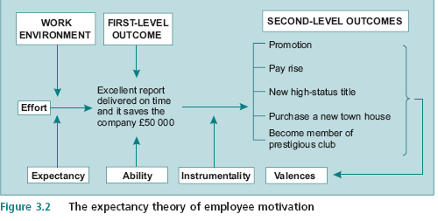
Dr.Ahmed Radwan

Slide 45
Probabilities in Expectancy Theory
Instrumentality is the personal belief that first level outcomes lead to second level outcomes.
Positive instrumentality refers to employee believes a Second level outcome will occur given some level of performance.
Negative instrumentality refers to the employee belief that a Second level outcome will not occur after a given first level outcome.
Dr.Ahmed Radwan

Slide 46
Probabilities in Expectancy Theory
Expectancy is the subjective belief that a given level of effort will lead to a first level outcome .
Expectancies are judgments about the relationships between levels of effort and first level outcomes.
Feedback about performance and rewards (second level outcomes) is necessary to sustain high efforts.
The ability of the employee is an important component.
Dr.Ahmed Radwan

Slide 47
Work Environment
Work environment include both hygienes and motivators.
  The nature of supervision
  The rewards
  Performance appraisal systems
Dr.Ahmed Radwan

Slide 48
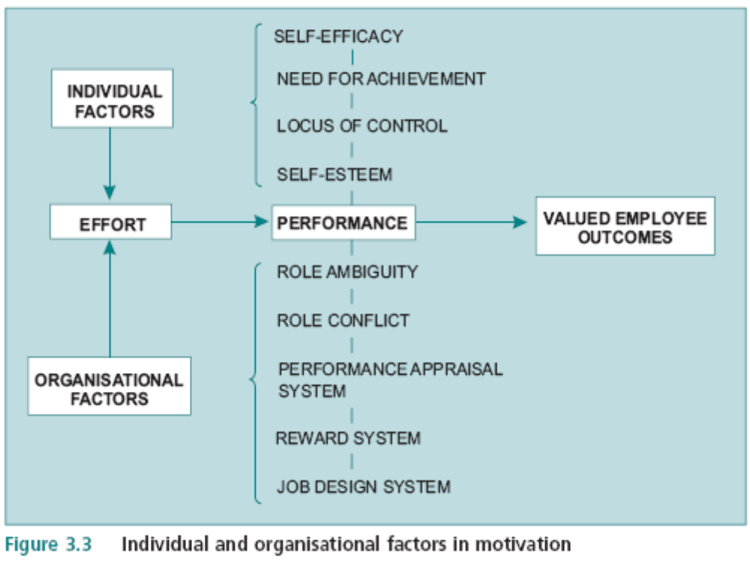
Dr.Ahmed Radwan

Slide 49
Individual Factors and Motivation
Locus of Control
  The individual with an internal locus of control believes that a strong connection exists between his behaviour and valued outcome
Positive Self Image
  Employees who have a positive self image believe that their ability will lead to successful performance.
  They have high expectancy that effort will lead to good performance.
Dr.Ahmed Radwan

Slide 50
Individual Factors and Motivation
The individual’s Need for Achievement :
It influences level of effort, instrumentality and expectancy.
The achieving employee is willing to expend much effort on the job if it represents a challenge to his skills and abilities.
If the achieving individual believes the organisation rewards performance instead of effort, then his instrumentalities will be high and positive.
Dr.Ahmed Radwan

Slide 51
Individual Factors and Motivation
If the achieving employee believes the organisation does not equitably reward performance, then he will leave.
Every frustrated employee with a high need for achievement is a potential entrepreneur!
Dr.Ahmed Radwan

Slide 52
Organisational Factors and Motivation
Role Ambiguity is an important motivational influencer.
It is defined as a lack of clarity or lack of understanding of job or work demands.
Supervisors should explain a job & give feedback about performance, employees are able to see the connection between effort, performance and second level outcomes.
Dr.Ahmed Radwan

Slide 53
Organisational Factors and Motivation
Role Conflict is having two sets of work expectations which are in disagreement.
Management is often sources of role conflict, when employees report to more than one supervisor.
When role conflict and role ambiguity are both high, the employee perceptions about expectancy and instrumentality deteriorates.
Dr.Ahmed Radwan

Slide 54
Organisational Factors and Motivation
The Organizational Performance Appraisal System plays an important role in expectancy theory.
  Excellent systems provide periodic feedback formally and informally during the year.
Dr.Ahmed Radwan

Slide 55
Organisational Factors and Motivation
The primary goals of performance appraisal are:
1) Informing employees about where they stand relative to performance
2) Developing information to make personnel decisions,
e.g., promotion, pay rises and termination
3) Identifying employees with training and development needs.
Dr.Ahmed Radwan

Slide 56
Organisational Factors and Motivation
Supervisors should make informed recommendations for pay rises, promotions, training programmes and terminations.
Employees will recognise that a dependable relationship between performance and reward exists.
This will lead to higher levels of effort, performance and job satisfaction.
Dr.Ahmed Radwan

Slide 57
Organisational Factors and Motivation
The Reward System :
Supervisors should keep employees informed about requirements for successful job performance.
If the system is not fair, it triggers lower motivation, performance and job satisfaction for high performers. The valence of alternative jobs increases for them!
Dr.Ahmed Radwan

Slide 58
Organisational Factors and Motivation
The Job Design System :
Most employees prefer more control rather than less control over their work.
Employees try to satisfy their control and autonomy needs by getting promotions.
Dr.Ahmed Radwan

Slide 59
Organisational Factors and Motivation
Organisation must make existing jobs more challenging and fulfilling.
To do this , reward employees for acquiring new skills.
The more skills they learn, the more control they acquire over their work assignments.
Managers can also delegate authority of more tasks to subordinates.
Dr.Ahmed Radwan

Slide 60
Cultural Differences in Motivation
Differences among cultures do exist and apply to:
1) Socially acquired need theory
2) Maslow’s hierarchy
3) Herzberg’s two factor theory
4) Expectancy theory.
Dr.Ahmed Radwan

Slide 61
Cultural Differences in Motivation
Examples:
  The Greeks and Japanese regard security as the most important need.
  Individuals in some cultures fail to value need for achievement.
  In Sweden and Norway, belongingness needs are highly valued.
Dr.Ahmed Radwan

Slide 62
Cultural Differences in Motivation
In New Zealand ,supervision and relationships with peers are classified as motivators while American workers generally consider these to be hygiene factors.
In cultures which value cooperation and collaboration, principles of expectancy theory break down because the theory is individually based rather than team based.
Dr.Ahmed Radwan

Slide 63
Behaviour Modification,
(Operant Conditioning )
The process and content motivation theories emphasize that people are motivated by thoughts, feelings, sentiment and mental processes.
They are cognitive theories that specify the individual as the originator and processor of motivated behavior.
Dr.Ahmed Radwan

Slide 64
Organisational Behaviour Modification
B. Modification is a process theory which describes the role of the environment in shaping the behavior of employees.
Behavior modification de-emphasises the role of the individual in the motivation process and emphasizes instead the role of the environment.
B. Mod. predicts that behavior occurs because of the learned connection between behavior and rewards.
Dr.Ahmed Radwan

Slide 65
Key Definitions in
B Modification
Reinforcer
  Behaviour modifier through its consequences
Law of Effect :
  Tendency to repeat behaviors which cause favorable consequences, and not to repeat behaviors which cause unfavorable consequences
Dr.Ahmed Radwan

Slide 66
CONTINGENCIES OF REINFORCEMENT
CONSEQUENCES
PRESENTED
CONSEQUENCES
REMOVED
POSITIVE REINFORECEMENT
EXTINCTION
PLEASANT
CONSEQUENCES
PUNSHMENT
NEGATIVE
REINFORECEMENT
UNPLEASANT
CONSEQUENCES
Dr.Ahmed Radwan

Slide 67
Contingencies Of Reinforcement
Positive Reinforcers :
  Favorable or pleasant consequences
Negative Reinforcers
  Withdrawal of unfavorable or unpleasant consequences
  Negative Reinforcement, the behavior that is strengthened is the one that helps the person to avoid an unpleasant consequence (being rewarded by the relief of discomfort).
Dr.Ahmed Radwan

Slide 68
Contingencies of Reinforcement
Extinction
  a pleasant consequence is removed or a neutral consequence occur to weaken a behavior.
Punishment
  an unpleasant consequence is presented.
Dr.Ahmed Radwan

Slide 69
Positive Reinforcement
A behavior is strengthened by the occurrence of pleasant consequences.
  A manager gives a subordinate a difficult assignment to save expenses.
  The employee exerts great effort and completes it on time .
  The manager reviews the work & the employee is given 25 % of the savings as a bonus.
Dr.Ahmed Radwan

Slide 70
Negative Reinforcement
A behavior is strengthened by removal of an unpleasant consequence
  To take away the unpleasant situation.
It is called avoidance learning.
  E.g. employees come to work on time to avoid reprimands.
Negative reinforcement is available in most organizational policies.
  Forbidden behaviors are specified in an employee handbook.
Dr.Ahmed Radwan

Slide 71
Extinction
Extinction
  Weakening a behaviour with occurrence of a neutral consequence or removal of a positive consequence
A behaviour is weakened if a positive consequence does not follow.
  For example, an employee engages in distracting conversations with his fellow workers. They ignore him.
Dr.Ahmed Radwan

Slide 72
Punishment
A behaviour is weakened by the introduction of unpleasant stimulus as a consequence occurs after the wrong behaviour.
  A supervisor issues a humiliating public reprimand to the employee.
Dr.Ahmed Radwan

Slide 73
Rules of Effective Punishment
Punishment is an effective behavioral change strategy when it is:
  Quick
  Intense
  Fair
  Focused
  Private
  Informative
  Not followed by rewards
Dr.Ahmed Radwan

Slide 74
Punishment Drawbacks
Opponents to the use of punishment in organisations have the following objections :
1 -To be effective, managers must closely monitor employee behaviour.
2 - Punishment never eliminates undesirable behaviour. It only suppresses it temporarily.
When it is removed, the undesirable behaviour returns.
3 - Employees become anxious, fearful and less creative.
Dr.Ahmed Radwan

Slide 75
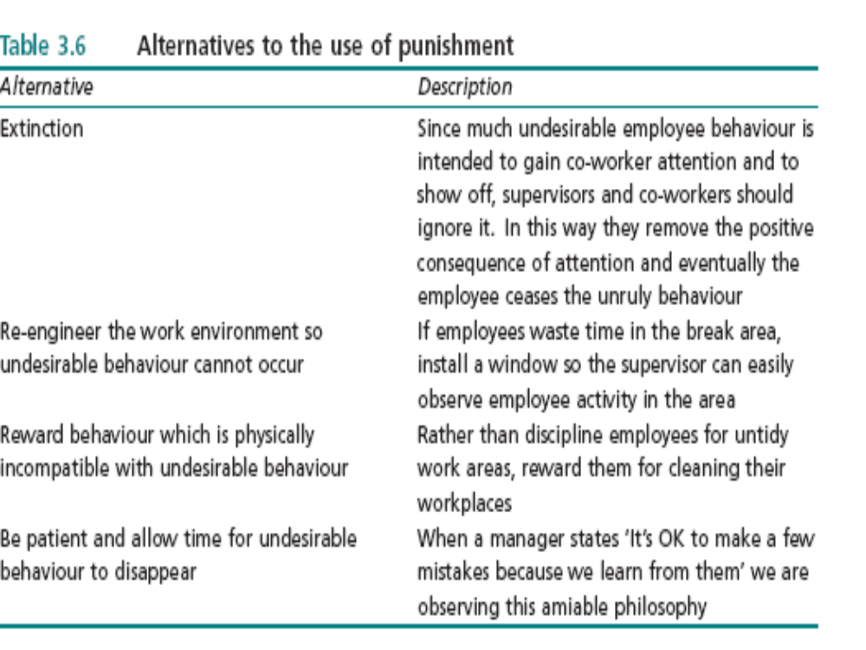
Dr.Ahmed Radwan

Slide 76
Contingencies of Reinforcement
Positive and negative reinforcement increase the strength of a behavior.
Punishment and extinction reduce behavior strength.
Punishment is unpleasant & should not be confused with negative reinforcement (pleasant & considered as a reward).
A contingency of reinforcement can be adapted to continuous or partial reinforcement .
Dr.Ahmed Radwan

Slide 77
Key Concepts in B Modification
Behavioural Shaping
  Successively closer approximations of desired behaviour
Schedule of Reinforcement
  Frequency with which reinforcement accompanies behaviour
Stretching the Ratio
  Altering the rate of reinforcement
Dr.Ahmed Radwan

Slide 78
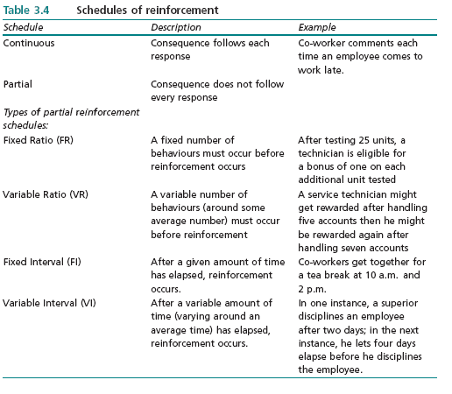
Dr.Ahmed Radwan

Slide 79

Partial Reinforcement Schedules
Behaviour learned under partial reinforcement schedules is more resistant to change.
  Four types are used:
    Fixed Ratio
    Variable Ratio
    Fixed Interval
    Variable Interval.
Dr.Ahmed Radwan

Slide 80
Partial Reinforcement Schedules
    Fixed Ratio Schedule:
    Links consequences to a given number of behaviours.
    It produces a very high behavioural response rate.
    The variable Ratio Schedule
    Links consequences to an average number of responses.
    A variable ratio schedule implies that an uncertain (but around some average) number of responses must occur before the consequences is given.
Dr.Ahmed Radwan

Slide 81
Partial Reinforcement Schedules
    Fixed Interval Schedule
      Requires a constant amount of time pass before the consequence occurs.
    The Variable Interval Schedule
      means that a consequence is given for the behaviour after a variable amount of time has passed.
Dr.Ahmed Radwan

Slide 82
Stretching the Ratio and Interval of Reinforcement
  Stretching refers to shifting a reinforcement schedule from one rate to another more difficult to achieve rate.
  Stretching is NOT a way to use fewer rewards
  Stretching is used to keep employees from taking rewards for granted (continuous reinforcement)
Dr.Ahmed Radwan

Slide 83
Successful Behaviour Modification
B Mod programs designed on participation bases have a positive effect on performance.
Stretching the ratio or interval of reinforcement helps to sustain the strength of a desirable behavior
Dr.Ahmed Radwan

Slide 84
Behaviour Modification
Supporters View
Organizations are not free of manipulations and influence, these are natural aspects of organizational life.
The primary issue is whether or not employees are active participants in the design and administration of B Mod programs.
Dr.Ahmed Radwan

Slide 85
Behavioral Modification Critique
Applications of B Mod in industry work mainly when it is applied to highly routine tasks .
  Complex tasks require more creativity, and B Mod has less application.
B Mod is less useful if the work is machine paced rather than employee determined.
  For B Mod to work, employees must be able to select from a number of voluntary behaviors .
Dr.Ahmed Radwan

Slide 86
Behaviour Modification Programs
Setting up a good Behavioral Modification program requires the consideration of :
1) The level of employee management trust
2) Current levels of hygiene
3) Employee work which is not machine paced
4) Levels of employees abilities
5) How employees will receive performance feedback
6) The level of supervisory commitment
Dr.Ahmed Radwan

Slide 87
Setting up a Behavior
Modification Program
1- Conduct a Job Analysis
to ensure full understanding of job responsibilities.
  Employees should understand all the basic requirements of their jobs.
2- Define Performance Behaviors and set performance goals.
Dr.Ahmed Radwan

Slide 88
Setting up a Behaviour
Modification Programme
  Management must define the meaning good of performance so employees understand what they must do to be successful.
  Reasonable goals set for performance with their subordinates
  Goals should be specified in numbers easily understood by all employees.
Dr.Ahmed Radwan

Slide 89
Setting up a Behavior
Modification Program
3 - Conduct a Baseline Audit
to identify the rate of correct performance behavior
A baseline audit is simply a quantified point for initiating a B. Mod. program
  e.g. Accuracy rates in a certain task is 54 % , a target is 94%
  A deficiency of 40 % would thus be identified through the baseline audit.
Dr.Ahmed Radwan

Slide 90
Setting up a Behavior
Modification Program
4- Select Powerful and Abundant Reinforcers
to reward excellent performance.
5- Use Continuous Reinforcement
to encourage new performance behaviors.
  Praise and recognition are the most useful rewards in the beginning of the program.
Dr.Ahmed Radwan

Slide 91
Setting up a Behaviour
Modification Programme
6- Practice Behavioral Shaping
to obtain closer and closer approximations to the desired performance behavior.
  If employees experience a performance problem, they should not be criticized. use coaching.
7- Establish desired behaviors by adding new Positive Reinforces which employees value.
  An incentive system can be set up on a variable ratio or variable interval schedule
Dr.Ahmed Radwan

Slide 92
Setting up a Behaviour
Modification Programme
8- Stretch the Ratio or Interval
to move employees to a sustained level of performance.
9- Review and Evaluate the Program
to identify and measure target goals such as
  Cost reduction
  Employee attendance
  Safety
  Improved productivity.
Dr.Ahmed Radwan

Slide 93
Initiating a Behavior
Modification Programme
1 - Trust must exist between employees and supervisors.
2 - Employees must believe good work hygiene exists..
3 - Employees must have control over their work.
4 - Employee ability cannot be a cause of the problem.
5 - Employees must understand performance measure .
6 - Employees must get regular feedback about progress.
7 - Supervisors must be trained and committed.
Dr.Ahmed Radwan

Slide 94
December 2001 Exam
Define the term organizational commitment.
  In what ways does this concept differ from job involvement?
How can managers improve both organizational commitment and job involvement in their organization?
Dr.Ahmed Radwan

Slide 95
December 2002 Exam
Outline the major sources of stress at work.
What individual factors can reduce the stress that people experience?
Dr.Ahmed Radwan

Slide 96
June 2005 Exam
In discussion with your Director, she said that the company does not seem to have people that are committed as they were in the past.
She accepts that one of the reasons for this might be the changes that have occurred in the company over the past few years, especially with downsizing and de-layering.
Dr.Ahmed Radwan

Slide 97
June 2005 Exam
Nonetheless, she thinks the company should be doing things to encourage good employee work attitudes.
She has asked you, based on your study of OB in your MBA, to clarify the determinants of work related attitudes and to advise what the company should do. What do you advise?
Dr.Ahmed Radwan

Slide 98
December 2003 Exam
Which of the socially acquired needs do you consider to be of the highest value?
How has the manager's job changed in the downsized organisation of the 1990s?
Dr.Ahmed Radwan

Slide 99
June 2004 Exam
Your company has just lost a case at an Industrial Tribunal following a claim from a member of staff that the company had failed in its Duty of Care to employees that had resulted in an emotional breakdown.
The senior management teams are split in what they think the company needs to do as a result of the case.
Dr.Ahmed Radwan

Slide 100
June 2004 Exam
On the one side, some people think that pressure is now part of organizational life and that if some people can’t cope then they should leave the company to find an easier job.
On the other side, some consider that the company must now take the issue seriously and implement some support mechanisms.
You have been asked to present what you see as the key issues.
What would you tell the senior management team?
Dr.Ahmed Radwan

Slide 101
June 2004 Exam
Explain the similarities between Maslow's hierarchy and Herzberg's two-factor theory
How similar are B Mod and the expectancy theory? Identify at least three similarities between these two theories.
Briefly discuss the points which managers must consider before they install a B Mod program.
Dr.Ahmed Radwan

Slide 102
June 2005 Exam
One of your managers has an ongoing problem with one of his staff.
He has been trying to change the staff member’s behavior of continually interfering with the work of one of her colleagues (whose job she used to do).
He has so far tried moving the offender physically away from her colleague, ignoring the interference (along with the colleague) in the hope that it would stop, and rewarding the staff member when she does not interfere.
Dr.Ahmed Radwan

Slide 103
June 2005 Exam
This situation has now been going on for six months, your manager has run out of ideas, and he has asked for your help.
What advice would you give from your knowledge of motivation theory?
Dr.Ahmed Radwan

